Slide 1


Phase 1 & 2 Literacy Leaders Meeting
Wednesday 22nd July, 2026
EXTENDED VERSON

Slide 2
In this meeting:
Key Changes to Phases 1 & 2 Assessments
Analysing data and responding with reteaching and reviewing
New resources for Review
Phonics Check – how to prepare
Responding to DIBELS ORF data

Slide 3

Key Changes to Phases 1 & 2 Assessments
Why?
Changing the emphasis from encoding (spelling) to decoding (reading) in Phases 1 & 2 – so we don't unnecessarily hold students' reading progress back.
accommodation
necessary
definitely
bureau
Notes:
Pam Snow says:
Reading is recognition; spelling is retrieval.
When we look at a word, we recognise letters and groups of letters. Spelling is exponentially more difficult than reading because there are choices to be made when spelling words.
When you think about your own spelling,
Click – 4 words appear
there are plenty of words you read on sight, but may take a few attempts to spell!
Up until now, our advice has been to use only spelling test results to decide whether to reteach the entire lesson to the class. The rationale was that when a student can spell a word, they can most definitely read it.
This is a safe bet; however, the downside is that it can unnecessarily slow a group’s progress through the program when they could be moving on with their knowledge of the code.
Although we teach decoding and encoding simultaneously, we’ve seen that waiting for mastery of spelling before moving a group forward isn’t a good idea. This also includes the dreaded heart words!
SO: although we still want you to use the spelling tests to see what’s sticking in terms of correct orthographic choice and spelling rules, in phases 1 and 2, this data will ONLY inform the shape of review during lessons, but the decisions on whether to do an entire reteach of a teaching point will be based on decoding data.

Slide 4
Heart Words - Changes to Phases 1 & 2
Phase 1 Reading Test replacing spelling test
Phase 2 Reading Test added to the existing spelling test
Routines for teaching and reviewing Heart Words stay the same.
Students must always read AND write Heart Words in lessons

Slide 5
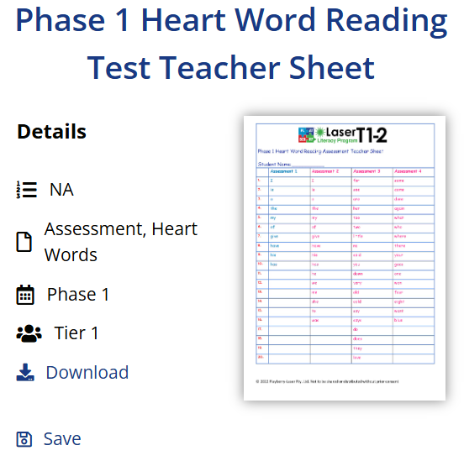
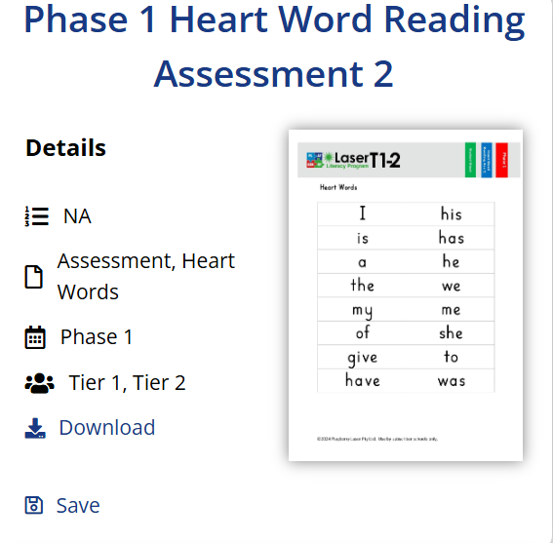
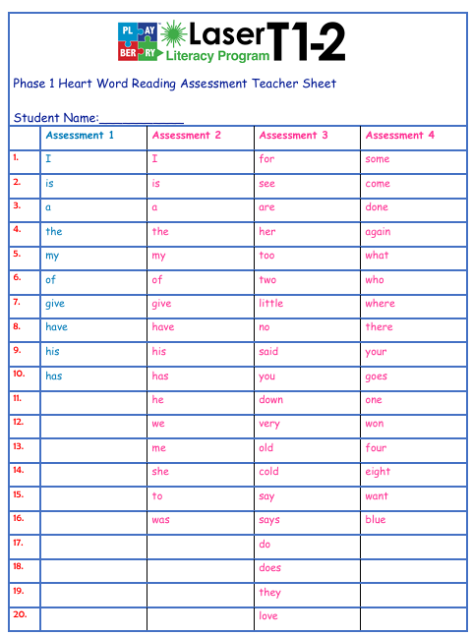
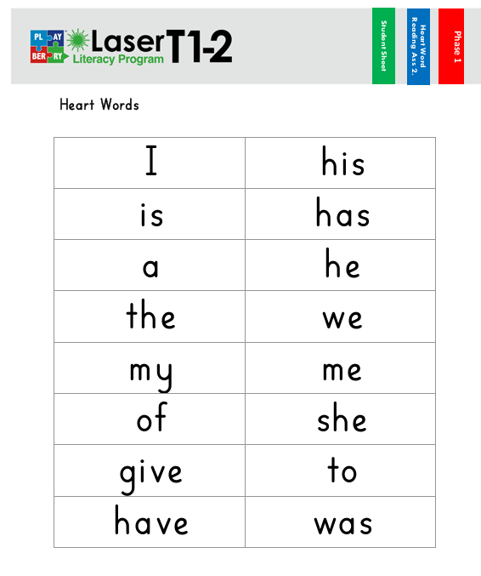

Slide 6
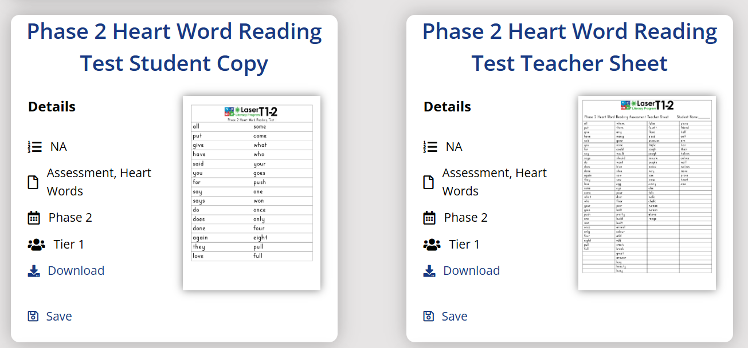
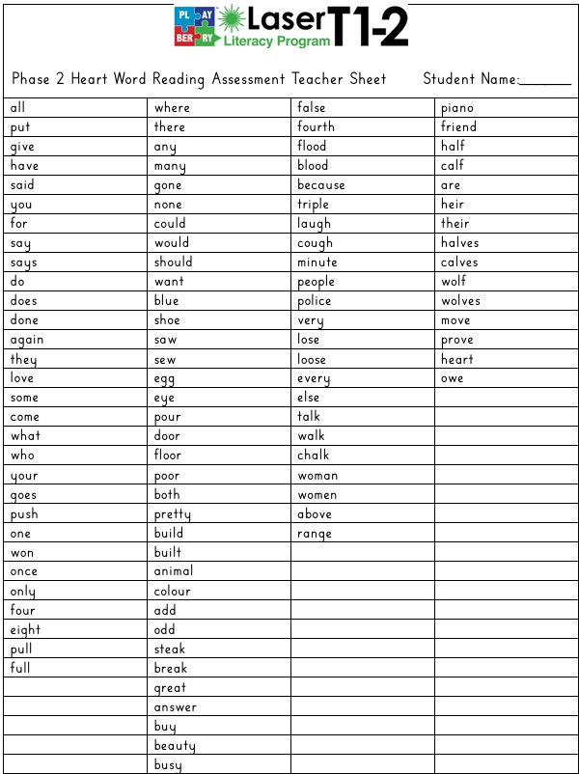
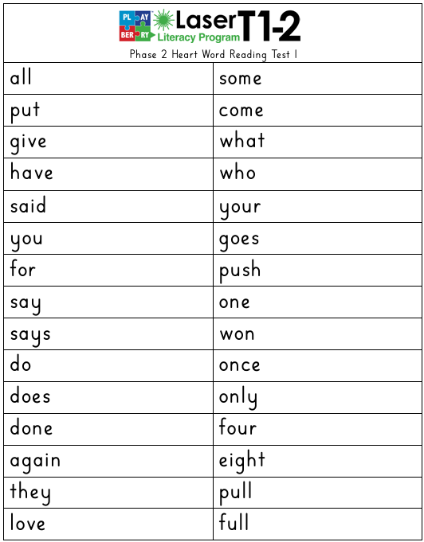

Slide 7
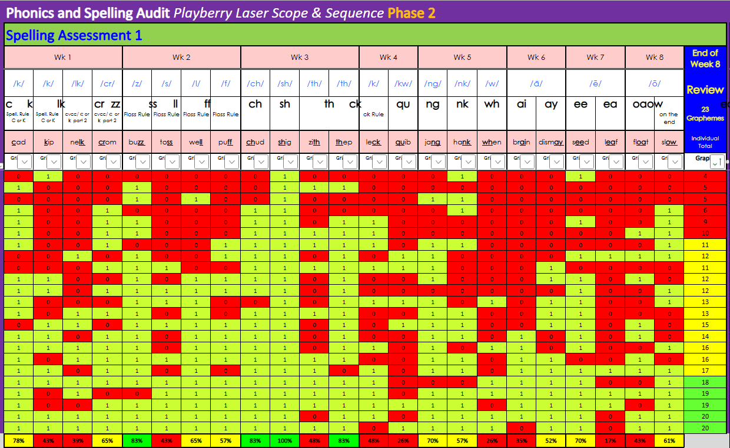
Phase 1 & 2 Assessments
Administer whole-class spelling test

Slide 8
Under 80%?
If yes: Administer decoding tests 1:1

Slide 9
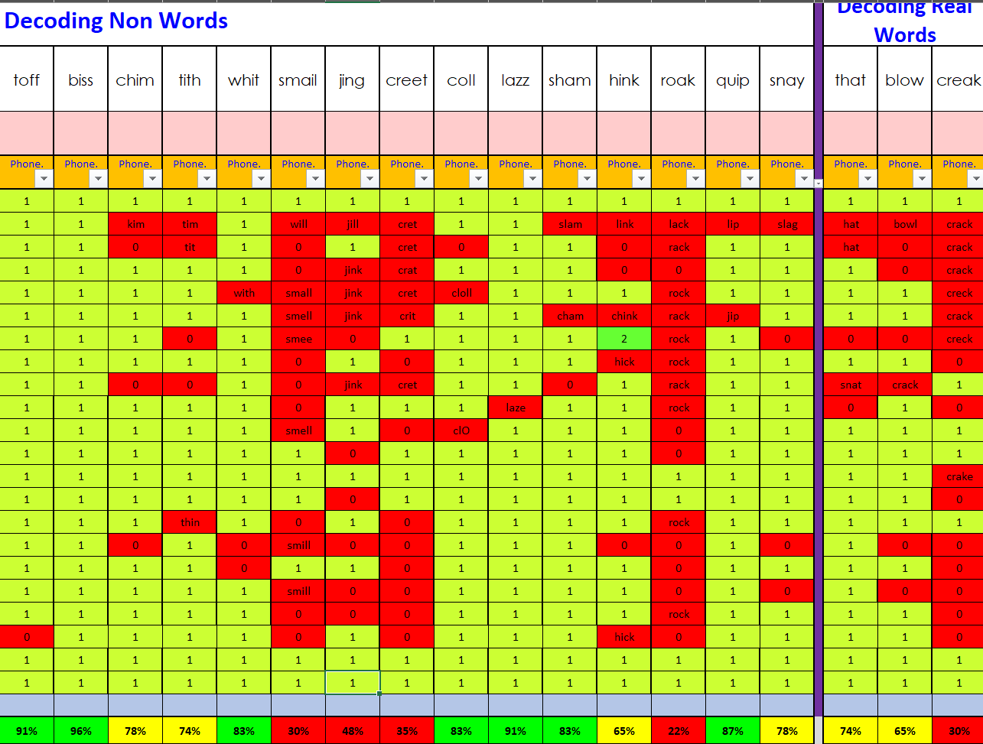
5 graphemes need reteaching:
(ai, ng, ee, oa, ea)
This is all done in the following week & then built into ongoing review.
Use decoding data to determine what to reteach & review

Slide 10
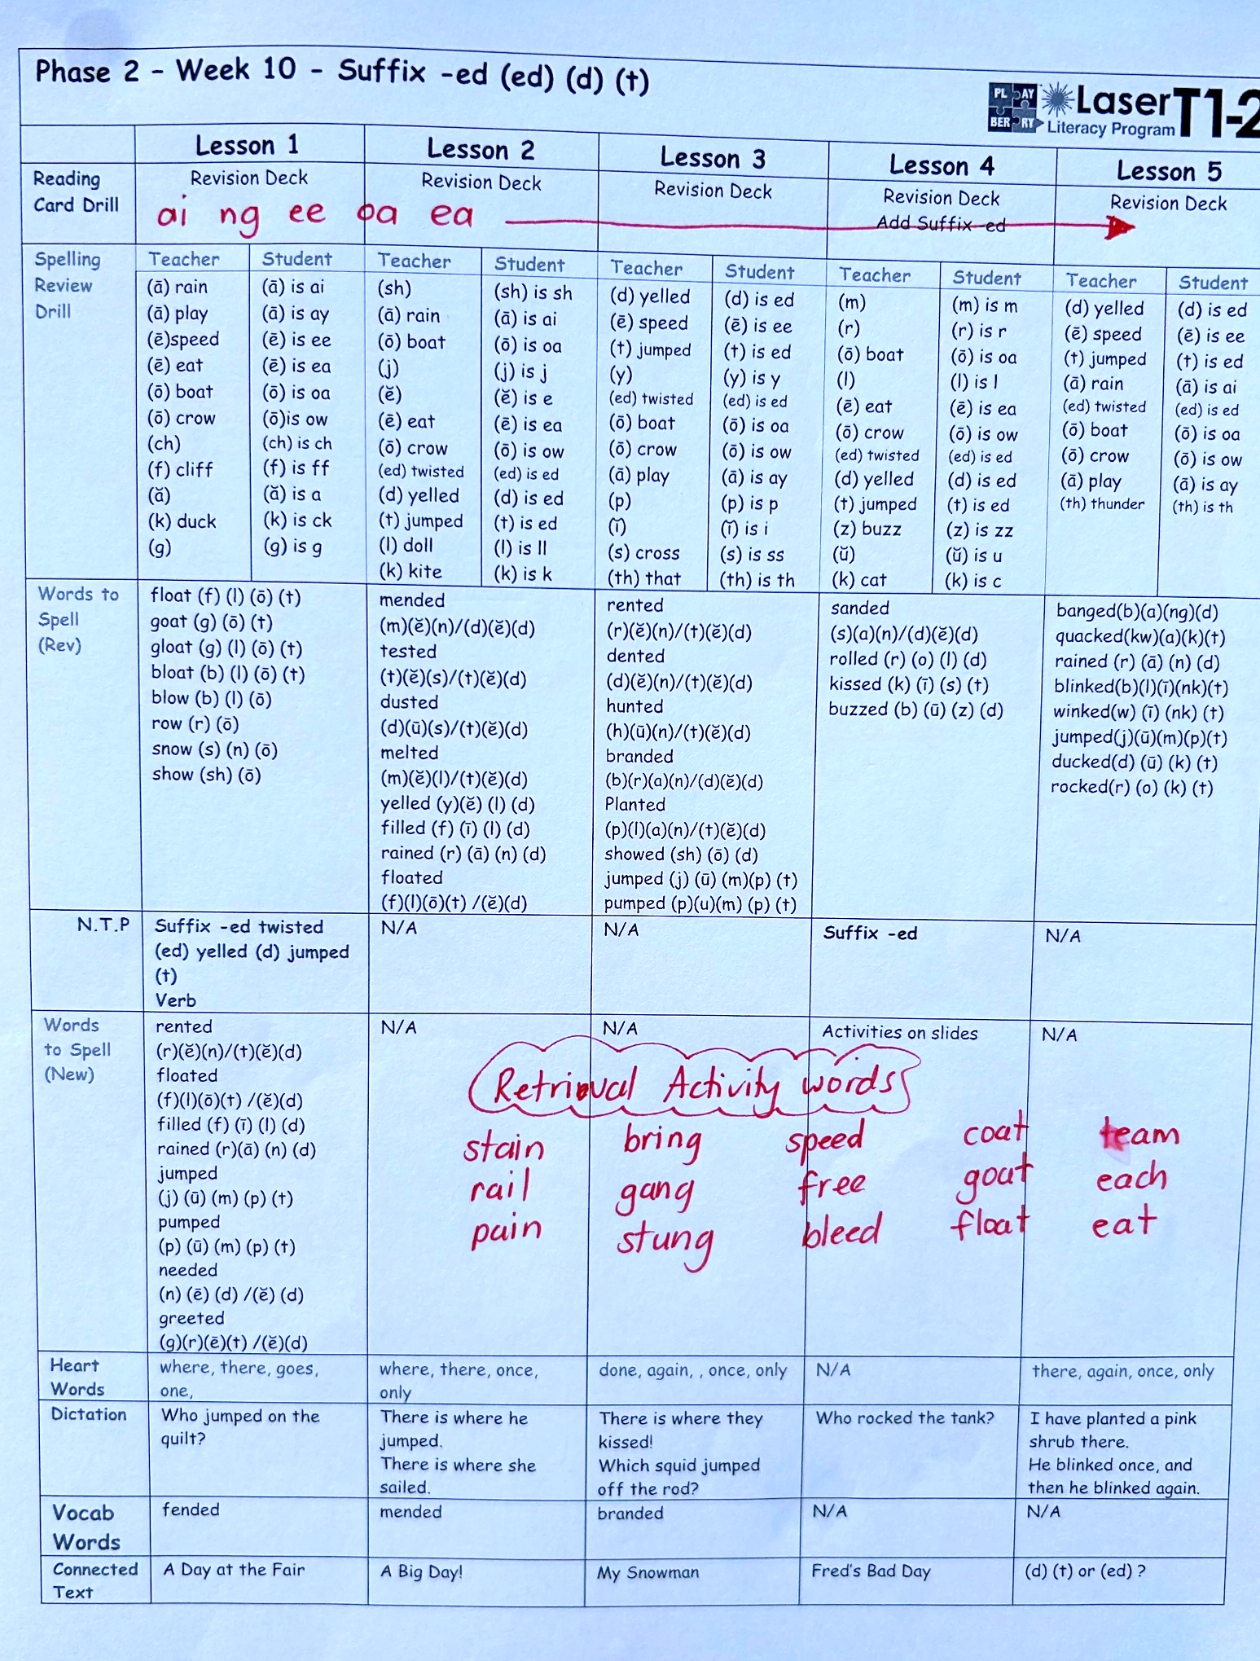
ai, ng, ee, oa, ea
Added to the Weekly Planner manually to ensure the review occurs.

Slide 11
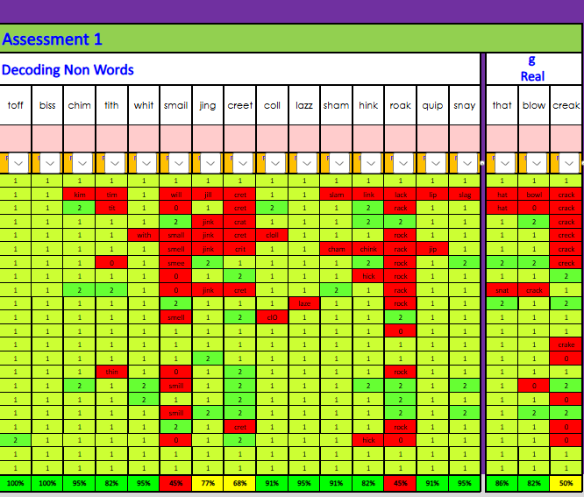
2 graphemes still not solid in reading: ai oa
Extra review required in and out of Playberry Laser lessons.
Use decoding data to determine what to reteach & review

Slide 12
‘k’ on the end, ss, th, qu, wh
Spelling data used to determine review for spelling

Slide 13
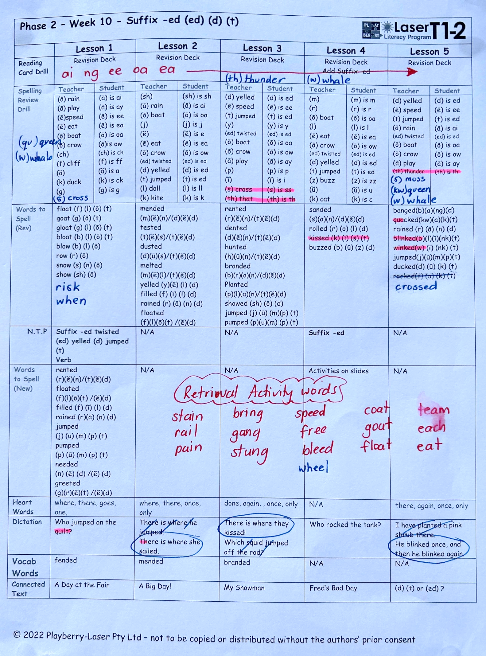
k on the end,
ss, th, qu, wh
Add manually to planner:
Spelling review drill
Retrieval Activities
Words to spell
Change dictation
Use spelling data to inform teaching via changes to planners/retrieval activities

Slide 14
New Resources for Review ​

Slide 15
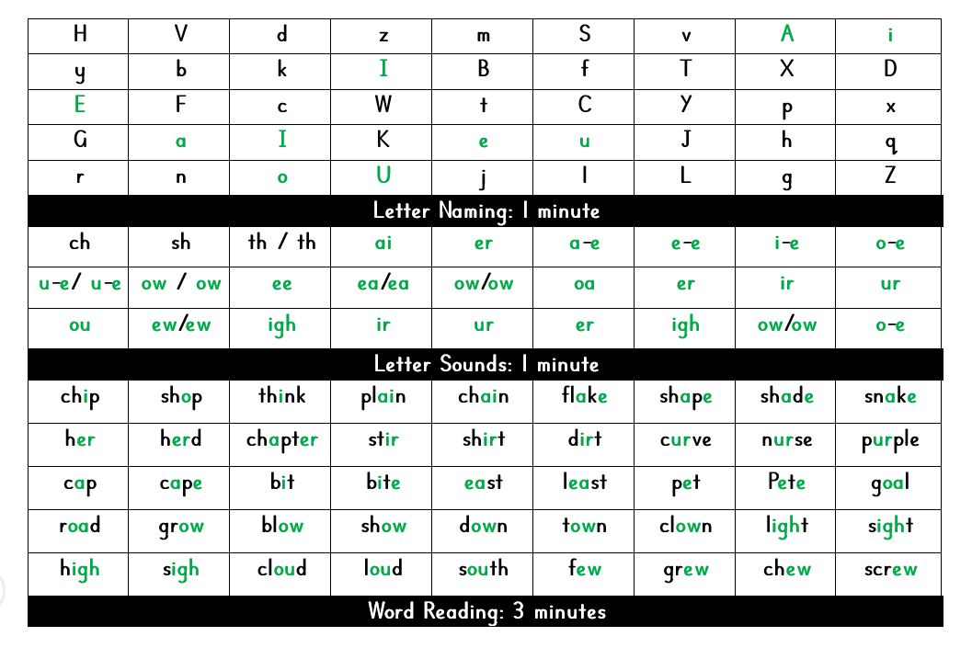
Outside of Playberry Laser Lessons
Phase 1 & 2 Review Sheets
whole class review
individual review
small group review
take home practice
These are available in the resources section

Slide 16
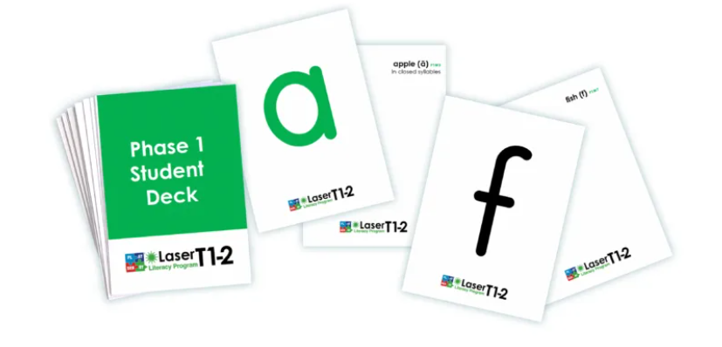
Outside of Playberry Laser Lessons
Phase 1 Student Deck of Reading Cards
for intervention / individual independent practice
$6 each or a class set of 25 for $125.

Slide 17

Heart Word Flashcards will be ready soon for purchase…

Slide 18
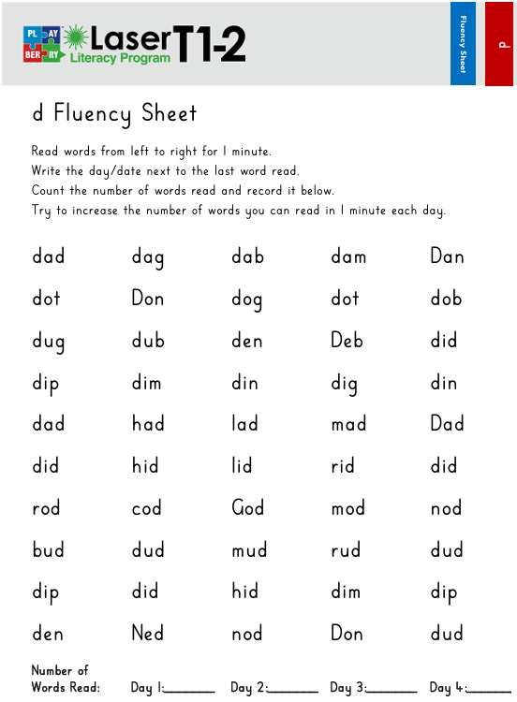
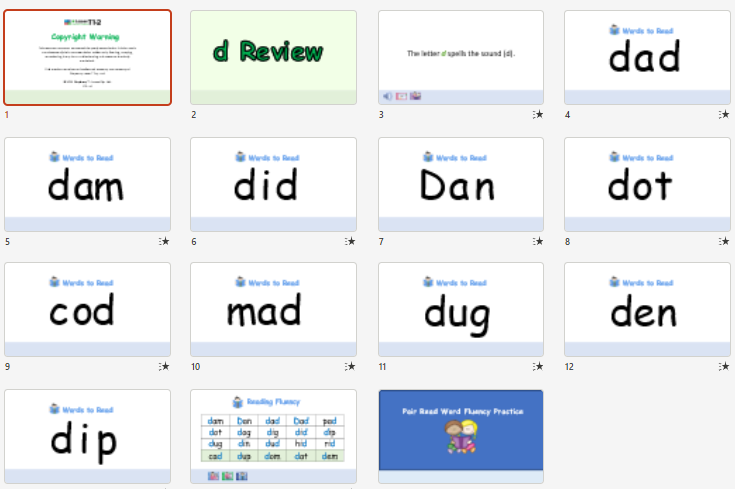
Outside of Playberry
Laser Lessons
Phase 1 & 2 Reading Review slides and worksheets
These resources can be found in the Phases 1 & 2 buttons. Slides are under the lessons and fluency sheets are in the Resources tab to the side.

Slide 19
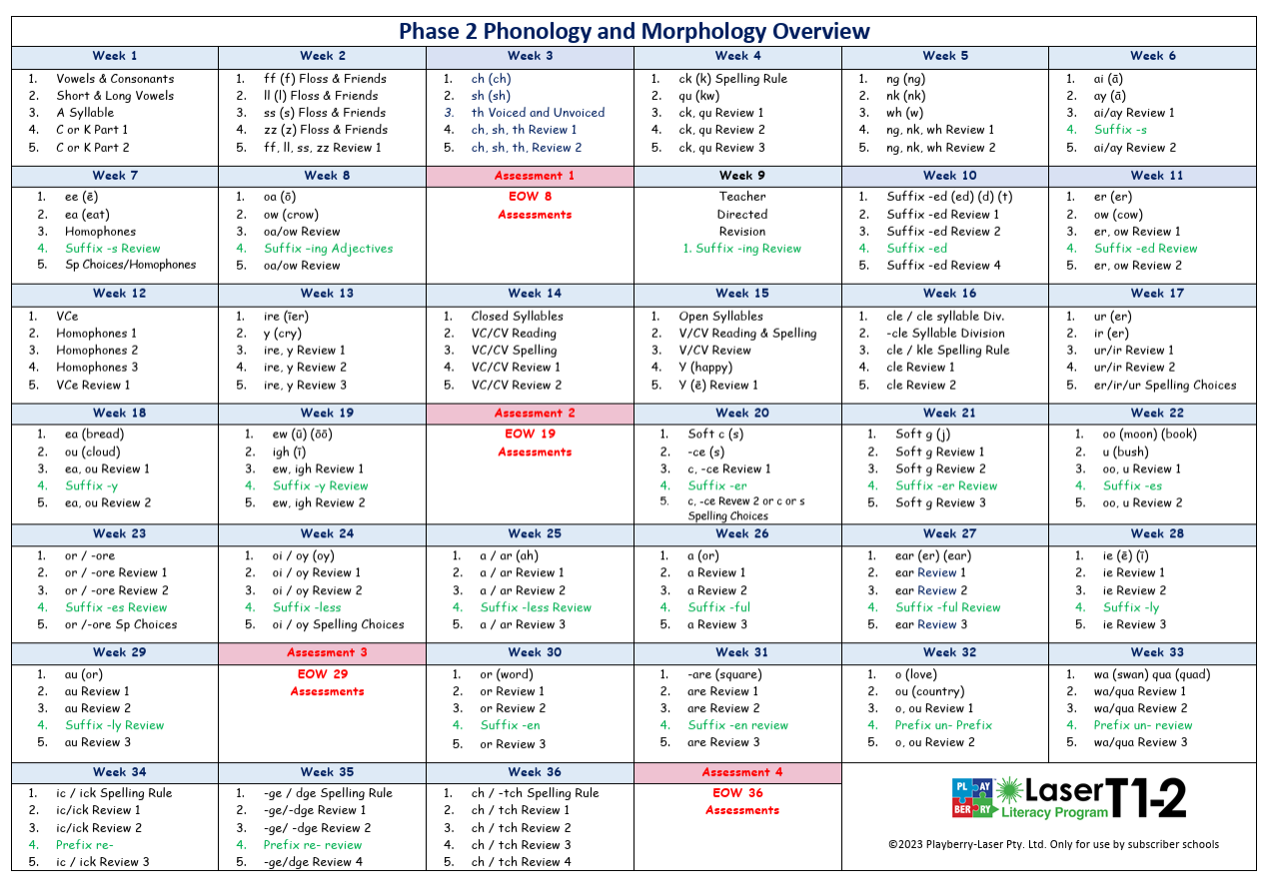
Students need to be at or around Week 25 of the Phase 2 Scope and Sequence to pass the Phonics Check.
If you’re not quite there……
Front-load graphemes by teaching using the Fluency
Review slides OUTSIDE of Playberry Laser lessons.
Review daily in Reading Card Drill in PL lesson.

Slide 20
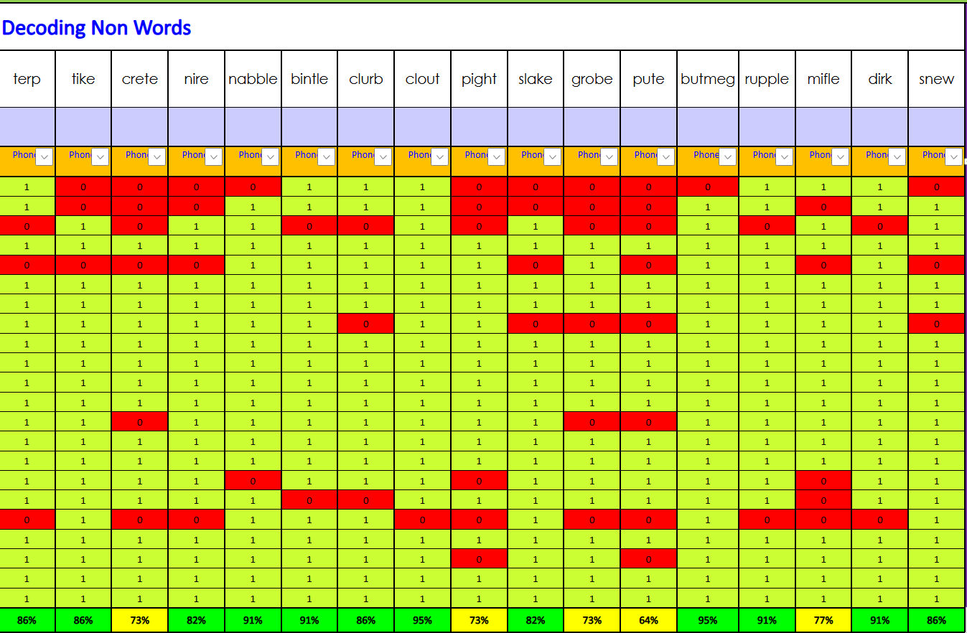
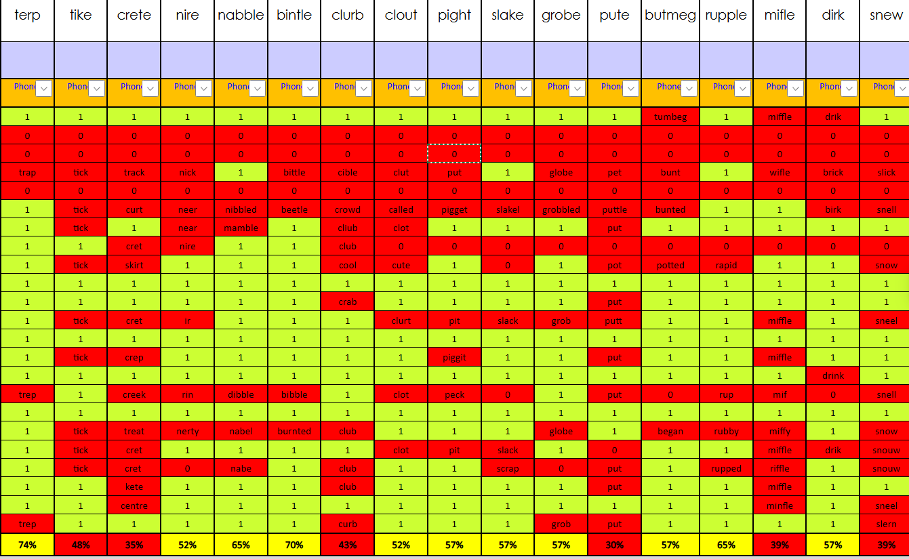
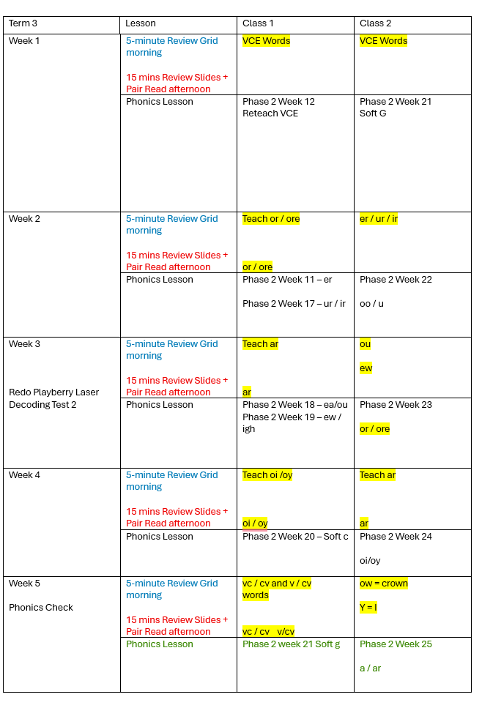
Recent decoding data – decision-making in preparation for the phonics check.

Slide 21
DIBELS​
Responding to DIBELS ORF

Slide 22

Dibels Data
If non-words are at Benchmark,
but ORF is not ...
Bump up your connected text reading in class to
I Do (Echo Read), We Do, You Do
+ Pair Read 1 & 2 (5 reads per day)

Slide 23
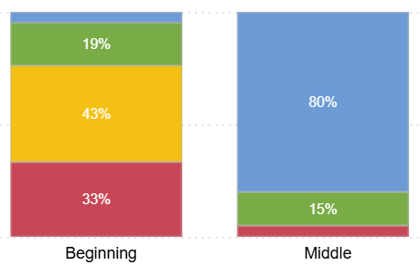
PL lessons started week 2
PL Writing started in 2026
5 minute ‘intervention’ started week 5
On-going instructional coaching
Progress Monitoring 3 wks
Parent Meeting held Tm 1
What can happen when you respond to the data​...
Notes:
C

Slide 24
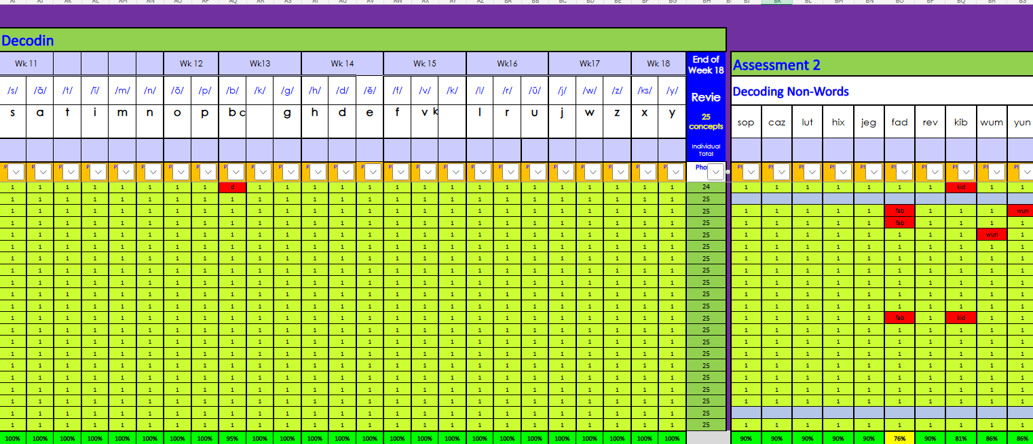
PL lessons started week 2
PL Writing started in 2026
5 minute ‘intervention’ started week 5
On-going instructional coaching
Progress Monitoring 3 wks
Parent Meeting held Tm 1
Reception Decoding Data
Notes:
C

Slide 25
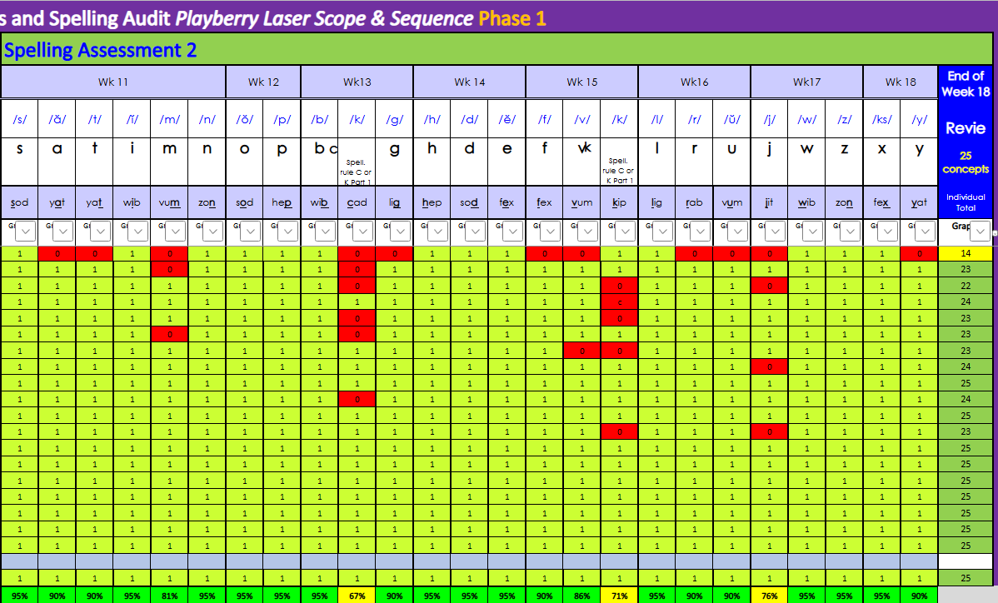
PL lessons started week 2
PL Writing started in 2026
5 minute ‘intervention’ started week 5
On-going instructional coaching
Progress Monitoring 3 wks
Parent Meeting held Tm 1
Reception Spelling Data
Notes:
C

Slide 26
Key takeaways:
Heart Words
  Phase 1 – assess reading only
  Phase 2 – assessment available for reading and spelling
  Flashcards available soon for ongoing reading practice
2. Use decoding data in Phase 1 & 2 to determine what to reteach
  Don't hold the class up because of spelling; just review and move on
  If 80% can't read the words, reteach AND review – you’ve got no choice, baby!
3. Reteach and Review
  Reteach (based on decoding data) ONLY teach the intro lesson, NOT the whole week
  Review – add to Weekly Planners and do extra practice outside of PL lessons with review resources.

Slide 27
4. Preparing for Phonics Check
  If the class will be up to Week 25 – play on
  If not, preload the PGC's using the fluency review slides outside of PL lessons
5. DIBELS ORF results
  Increase the amount of reading done in the class
  Add extra repeated oral reads using connected texts
6. Responding to data brings results!
  Spend time analysing the data and have steps in place to respond.
  Use the extra resources

Slide 28
Encourage and coach teachers to…
Ensure they give students opportunities to put their developing spelling skills into action each day, as often as possible.
This could be in structured Writing Lessons, HASS, Health, or any other curriculum area.

Slide 29
Also encourage and coach teachers to continue to…
Share lots of interesting and varied read-alouds with students.
Show an interest in what students borrow from the library.
Make a big deal when a new reading or writing skill is mastered.
Remember that for some students, mastery requires a lot of hard work.

Slide 30

And remember…
Teachers need love, coaching and encouragement as much as the kids do!

Slide 31
Congratulations on being here today and for all you do every day to help your colleagues and students thrive.

