Slide 1
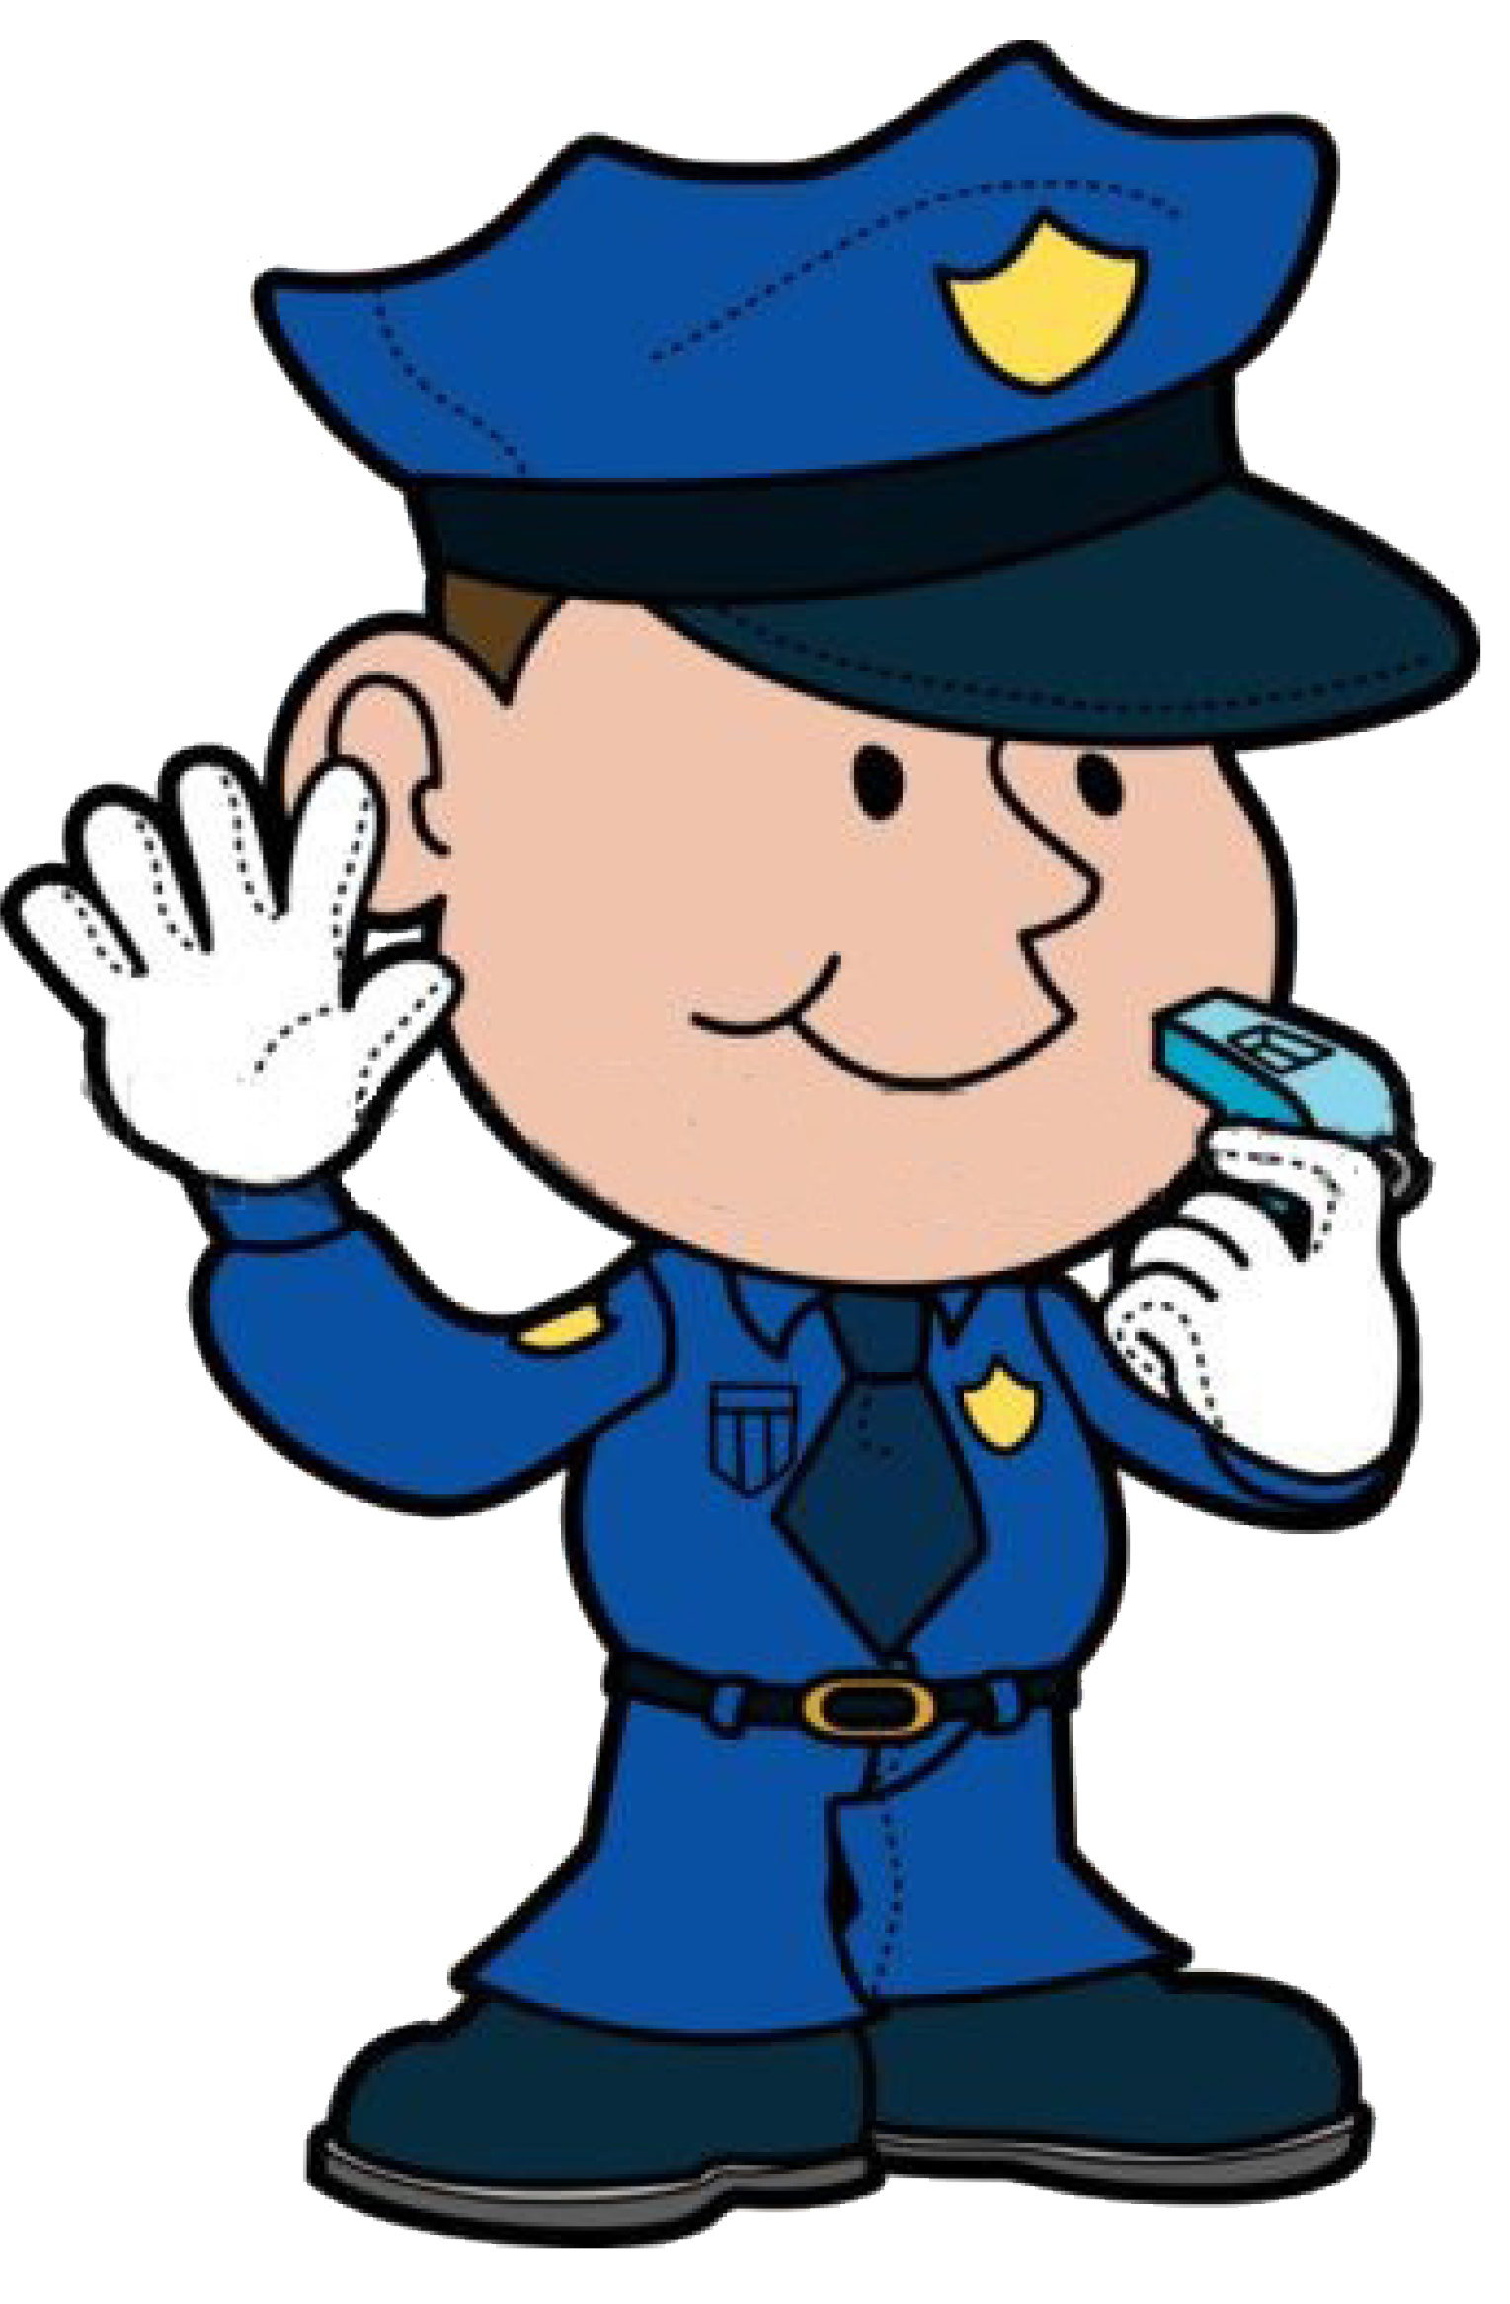
Dictation
Rewrite the sentence as a:
Statement .
Question ?
Command .
Exclamation !
Capital Letters
Order
Punctuation
Spelling

Slide 2
Dictation
Identify the:
    Noun
    Verbs
    Adjectives
    Pronouns
Capital Letters
Order
Punctuation
Spelling

Slide 3

Dictation
Write the sentence using this week’s:
HEART WORDS
Can you use more than one?
Capital Letters
Order
Punctuation
Spelling

Slide 4
Dictation
Rewrite the sentence and add a subordinating conjunction.
Examples: because, though, if, before, with, which . . .
Capital Letters
Order
Punctuation
Spelling

Slide 5
Dictation
Rewrite the sentence, changing the tense.
Example: write it in present / past / future tense.
Capital Letters
Order
Punctuation
Spelling

Slide 6
Dictation
Rewrite the sentence, adding
at least one extra:
adjective
adverb
Capital Letters
Order
Punctuation
Spelling

Slide 7
Dictation
Box the prefixes and the suffixes.
Capital Letters
Order
Punctuation
Spelling
reporting

